Slide 1
Cintra Self-Service Security Enhancement

Slide 2
Cintra Self-Service Additional Security Feature
  To improve the security of your Cintra self-service account, there’s a new safety feature called ‘Multi-Factor Authentication’ to held securely access Payslips, Statements & Letters.
  Benefits:
It adds more protection by requiring two or more methods of proving a person’s identity in order to access your secure information.
This means we can potentially use Cintra Self Service for more in the future.
Aligns us with the Corporation IT compliance.

Slide 3
Setting-up Multi-Factor Authentication
The additional self-service security feature is to be rolled out in two phases.
The first phase is to download the ‘Microsoft authenticator app’ from Play or App store.
The second phase is to link the ‘Microsoft authenticator app’ with your Cintra IQ self service account for two factor authentication.
What do you need to do?
You need to download the App on your mobile phone.
The ‘Microsoft authenticator app’ needs to be downloaded on your smart phone by 31st October 2024 which will enable us to roll out the second phase in November.
When both the phases are completed, when you log into your Cintra IQ self service account, the Microsoft Authenticator app will generate a one time 6-digit password.

Slide 4
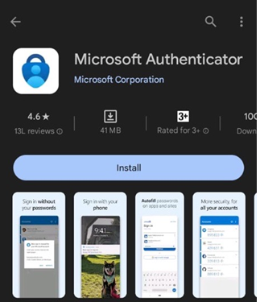
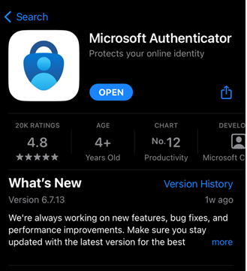
Download Microsoft Authenticator App
Open Play store for Android or App Store for iPhone to download Microsoft Authenticator App.
Android
iPhone

Slide 5
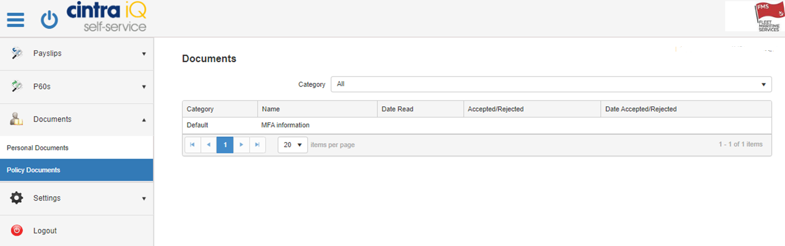
Download Microsoft Authenticator App
After downloading the app, you’ll need to verify it via the Cintra IQ Self Service by accessing the policy documents.
Desktop / Laptop display

Slide 6
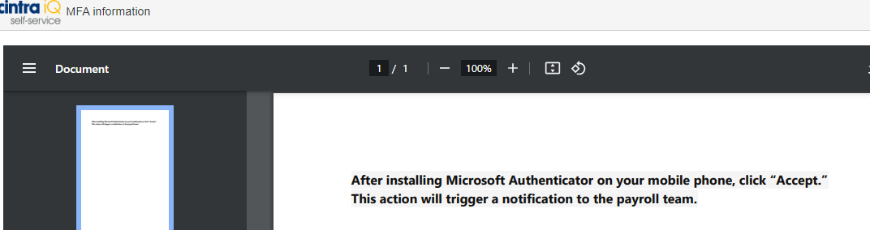
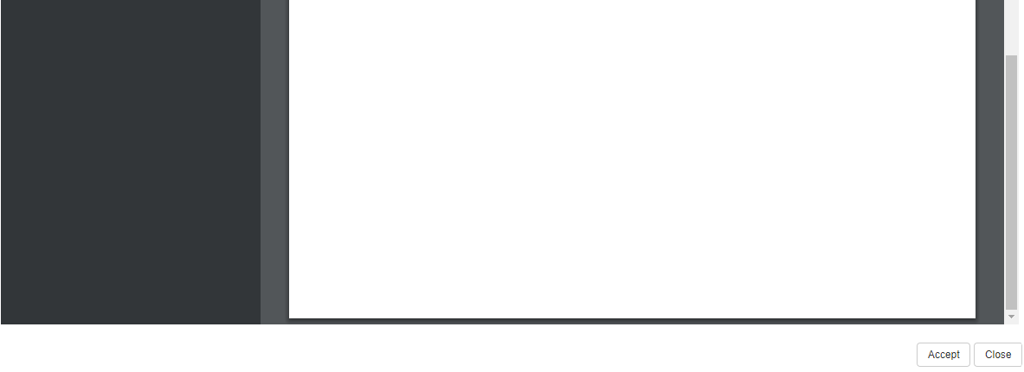
Download Microsoft Authenticator App
Read through the statement and click on ‘Accept’ for Payroll team to notify that App is downloaded
Desktop / Laptop display

Slide 7
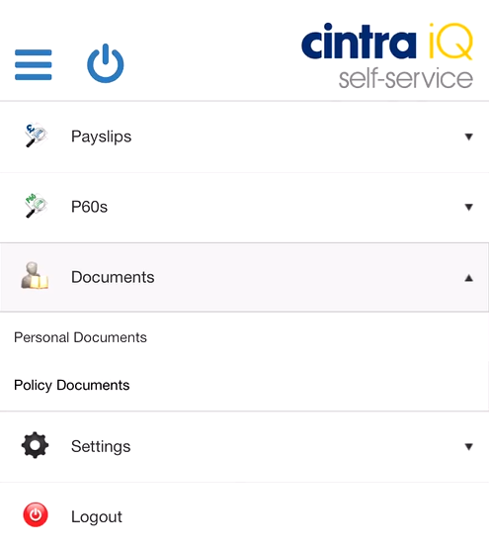
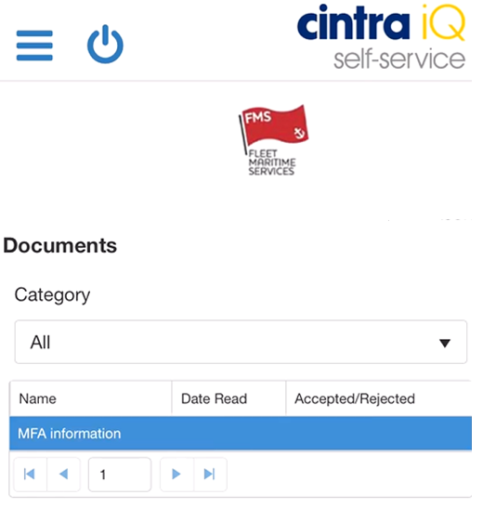
Download Microsoft Authenticator App
You can also confirm the app download by following these steps on your mobile phone via Cintra IQ Self Service: Click on Policy Documents and choose MFA Information
Mobile display

Slide 8
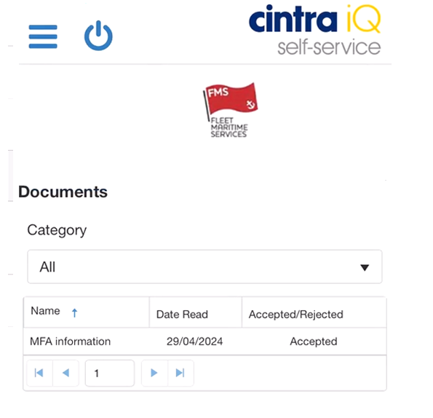
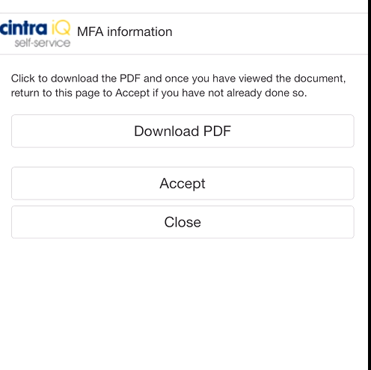
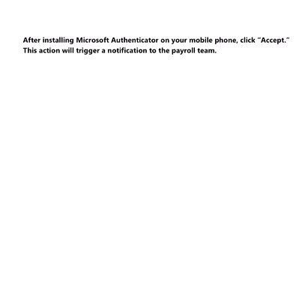
Download Microsoft Authenticator App
Select “Download PDF”, a separate PDF file will open. Review it and then click on “Accept”
Mobile display

Slide 9
Frequently Asked Questions (FAQ)
How would Multi Factor Authorisation will benefit?
It prevents unauthorized access to your sensitive information like payslip, Year end statement and letters.
Why is it required to download the Microsoft Authenticator App?
The Microsoft Authenticator App is required to link your Cintra IQ self-service account which will strengthen security of your account.
What will the Microsoft Authenticator app generate?
A. It will generate a 6-digit one time password that has to be entered during login into the Cintra IQ Self Service account.

Slide 10
Frequently Asked Questions (FAQ)
Q. Does the onboard free Wi-Fi connection enable to download the App?
Unfortunately, this app is not available to download from the App Store as part of the free sites onboard, despite our Technology teams investigating the possibility. It’s recommended that you use the complimentary "Crew Shore" network when available or other sources of free Wi-Fi ashore or in the terminals on port days.
What if I am leaving the ship before the 31st October 24?
The requirement to download the App remains the same, you can download the App while at home.

Slide 11
Frequently Asked Questions (FAQ)
What if there is a challenge in me being able to access a Wi-Fi Connection before end of October.
A. You need to inform to Crew office team who can collate the list and share with the Payroll team for further action.
What if the Microsoft Authenticator app is not downloaded by 31st October?
To continue accessing Cintra IQ self-service account it is mandatory to download the App. From the beginning of November, the Multi-Factor Authenticator will be active and when you login you need to enter a one-time password generated in App. Printed copies of your pay slip are available through the Crew Office.
When will the second phase instruction will be shared?
The instructions to link the Microsoft Authenticator App will be shared by end of the October.

